Slide 1
p Values and Error Bars What they tell you and what they don’t Jody Culham February 2021

Slide 2
Hypothetical Experiment
A scientist claims to have created a drug that improves intelligence
To test this, you compare two groups of subjects, one given the drug and one given a placebo (between-subjects design)

Slide 3
Null Hypothesis Significance Testing (NHST)
Attempt to disprove the null hypotheses that nothing’s going on
Example: Are people taking Drug X happier than those who are not?
H₀
Drug takers and placebo takers are equally happy
Frequency
IQ
Reject H₀
Hmmmm?
Frequency
IQ
IQ

Slide 4
The Cult of p
calculate confidence that null hypothesis is not true
p < .05 Hallelujah!
p > .05 Nooooooo!!! Life is ruined
“Surely Mother Nature loves p=.06 almost as much as p=.04” – Robert Rosenthal (my grad stats prof)

Slide 5
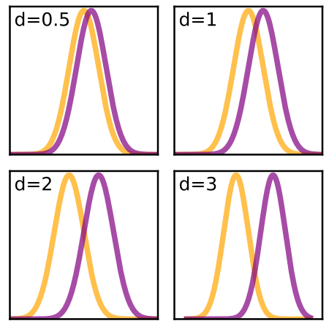
Effect Sizes

Slide 6
Statistical Significance ≠ Meaningfulness
p value depends on:
effect size
number of subjects
big effect size, moderate n → p is sig
big effect size, tiny n → p is not sig
small effect size, huge n → p is sig

Slide 7
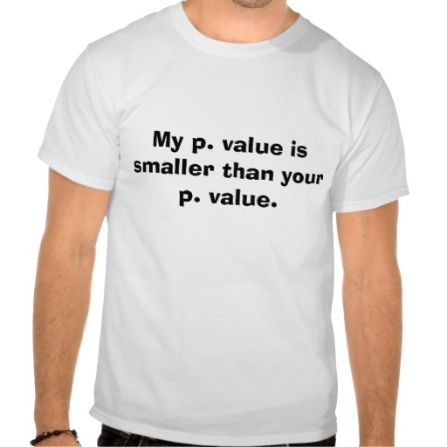
Dangers of comparing p values
IQ
+/- 95%CI
p = .001
p = .10
Faulty Logic
Blue effect is sig
Green effect is not sig
→ Blue effect is bigger than green effect

Slide 8
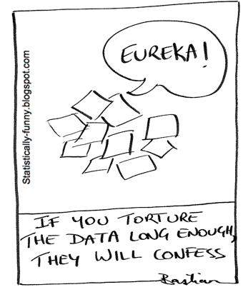
The Holy Grail of p<.05 Turns Researchers into Torturers

Slide 9
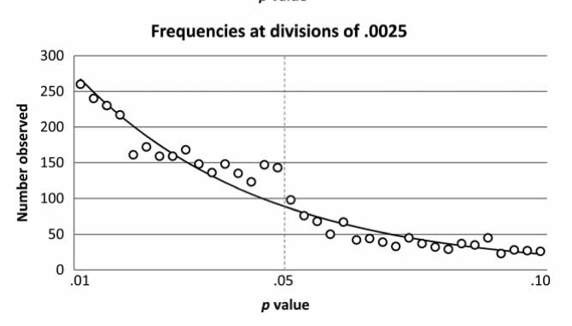

Slide 10
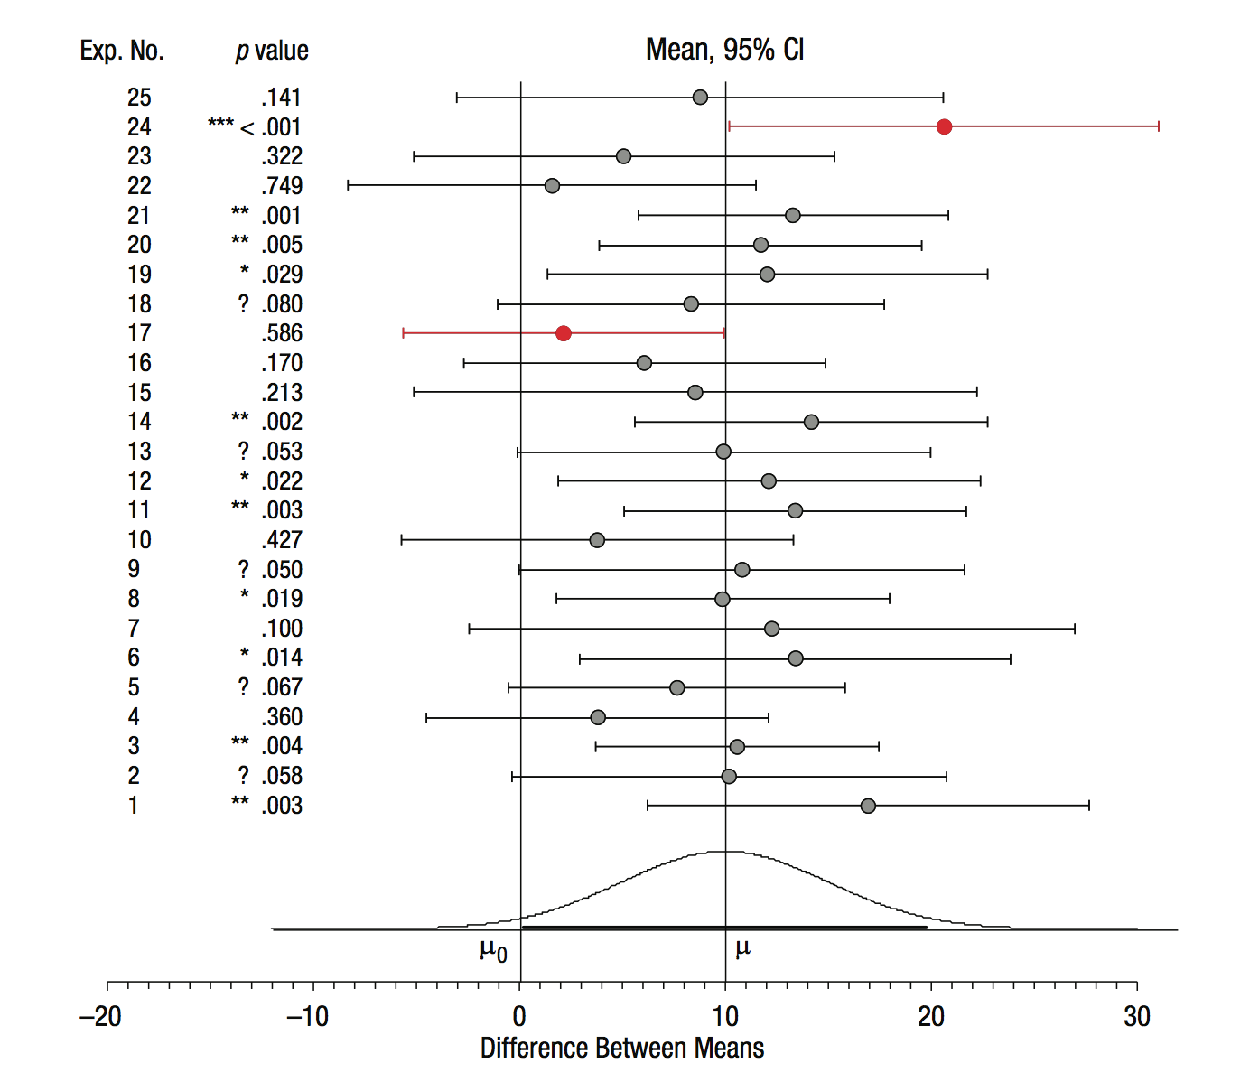
p values are VOLATILE!
Dance of the p values
https://www.youtube.com/watch?v=ez4DgdurRPg

Slide 11
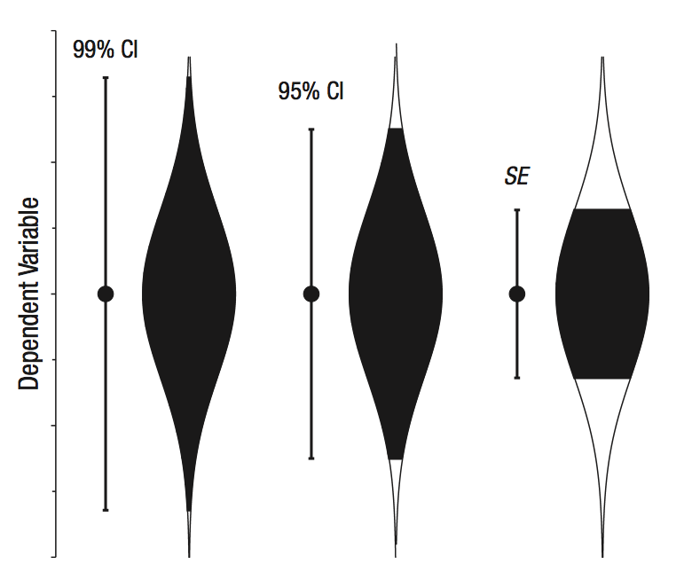
How can we do better?
Be aware of the limits of p
Do not compare p values
Do not say “X is more significant than Y”
Report effect sizes and not just statistics
Change the reward structure to reduce incentives to torture the data
Acknowledge the value of replication and meta-analyses
Use statistics for estimation

Slide 12
Why Graphs and Error Bars?
The picturing of data allows us to be sensitive not only to the multiple hypotheses that we hold, but to the many more we have not yet thought of, regard as unlikely, or think impossible.
-- Tukey, 1974
quote from Loftus & Masson, 1994

Slide 13
Popularity of Error Bars
growing use
often expected by reviewers, readers and listeners at talks
APA recommends them (but doesn’t seem to get them)
stat and graphics packages make them easy to add

Slide 14
What Do Scientists Think Error Bars Tell Them?
Add a second data point with equally-sized error bars such that the difference between the two groups is just barely statistically significant (by a two-tailed t-test, p < .05)
Most scientists follow the “just abutting rule” regardless of what the error bars represent
IQ
Placebo takers
Drug
takers

Slide 15
What Do Scientists Think Error Bars Tell Them?
Belia et al., 2005, Psychological Methods
Recruited 3,944 authors of papers in high-impact journals in Psychology, Behavioral Neuroscience, and Medicine and gave them that test online (15% return rate)
Also quantified use of error bars in publications in those fields
Psychologists don’t use error bars much
Neuroscientists usually use SE error bars in figures
Medical researchers report 95% CIs in text

Slide 16
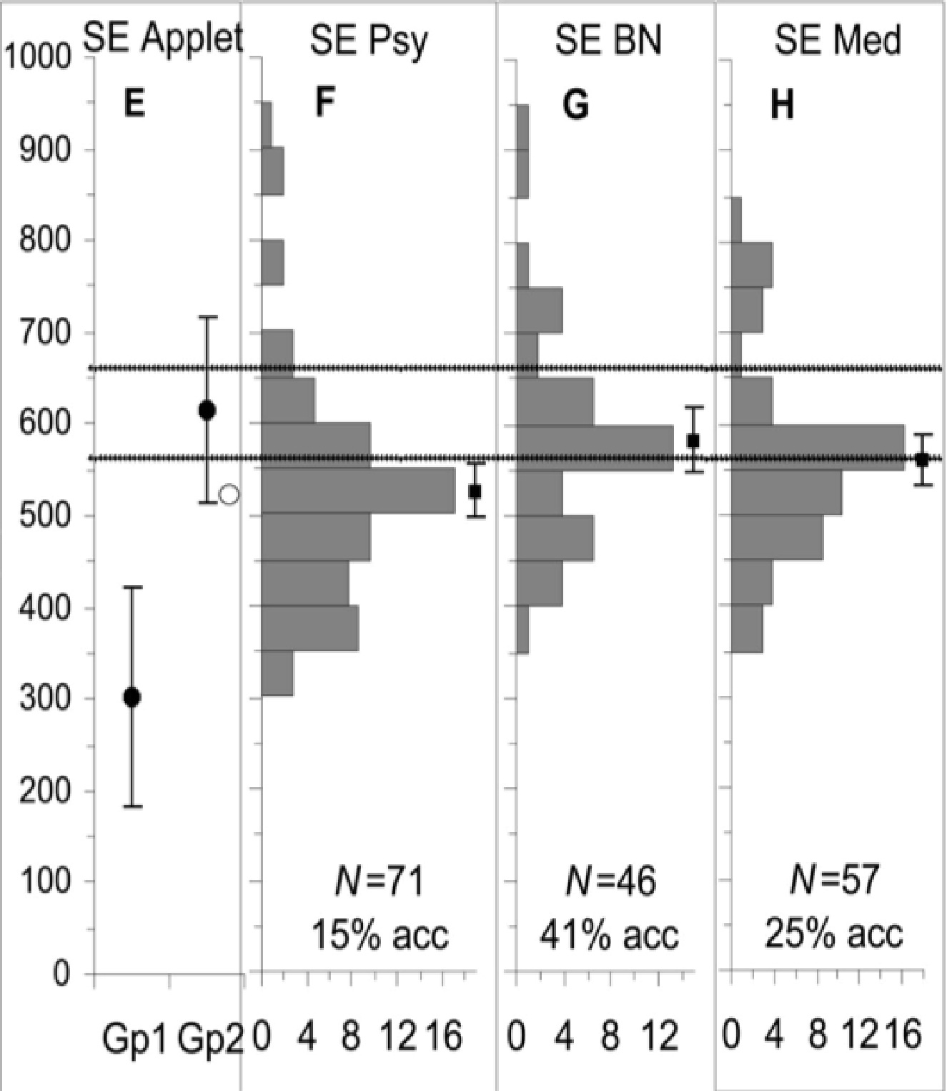
What Scientists Think SE Bars Tell Them
Correct
Responses
Psychology
Behavioral Neuroscience
Medicine
p < .025
p < .10
abutting rule of thumb
Belia et al., 2005

Slide 17
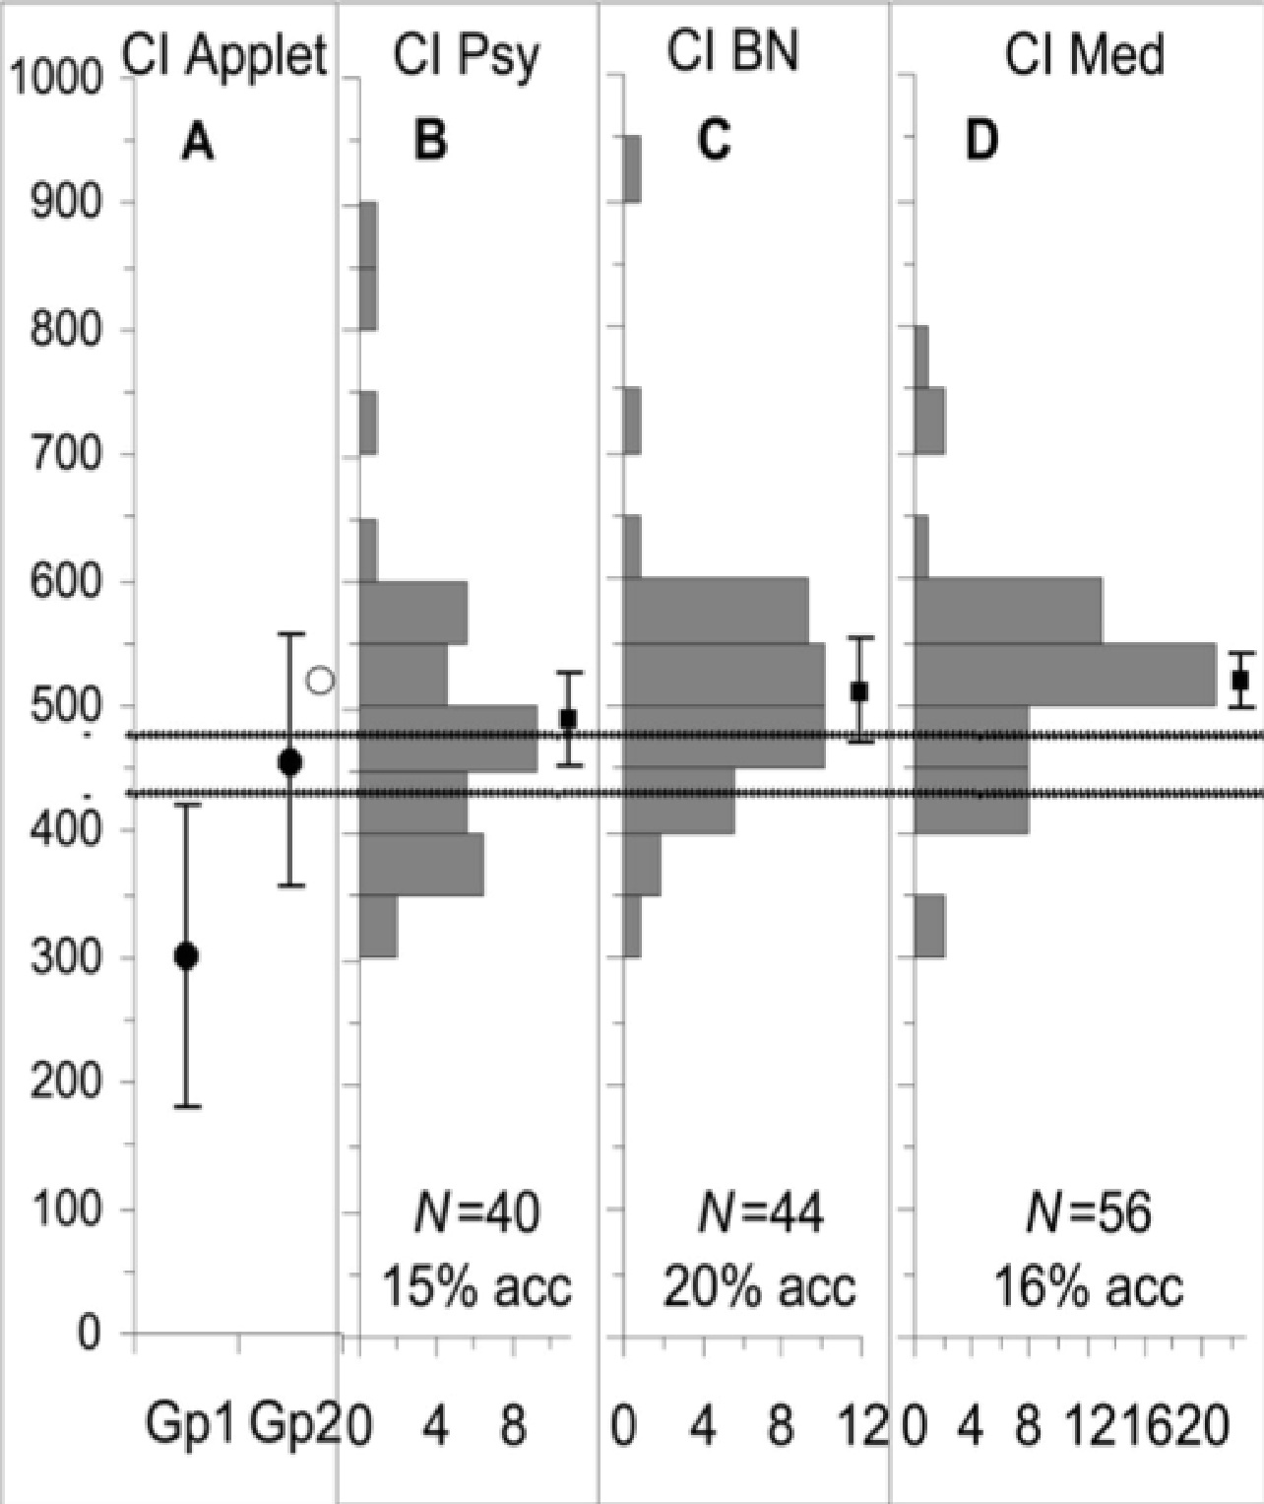
What Scientists Think 95%CI Bars Tell Them
Correct
Responses
Psychology
Behavioral Neuroscience
Medicine
abutting rule of thumb
Belia et al., 2005

Slide 18
What Do Error Bars Tell You?
It depends what type of error bars you use
standard deviation (SD)
standard error (SE)
95% confidence intervals (95%CI)
It depends what your questions are
“What is the likely mean of a population?”
Error bars, particularly 95%CI are valuable
“Are two groups significantly different?”
Error bars can be informative if you know how to interpret them
“Are two conditions tested in the same subjects significantly different?”
Conventional error bars are completely uninformative

Slide 19
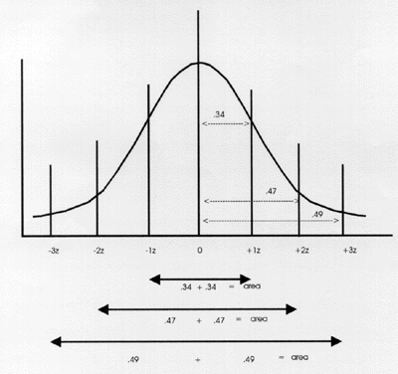
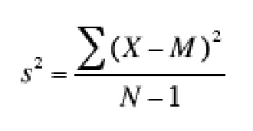
Computation of Standard Deviation
variance (s²) = spread around mean
standard deviation = s = SQRT(s²)
~average distance of points from mean (with outliers weighted heavily because of squaring)
adding more subjects doesn’t change SD, just the height!

Slide 20
What Does Standard Deviation Tell You?
120
SD = 15
100
80
60
IQ
40
20
0
Non-drug takers
Drug takers
SDs estimate the variability around the mean
Based on z distribution, 95% of individuals fall within +/- 1.96 SDs of the mean
Here the error bars are ~15, so most placebo takers have IQs between 70 (= 100 – 2*15) and 130 (= 100 + 2*15) while most drug takers have IQs between 80 and 140

Slide 21
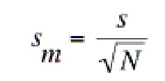
Computation of Standard Error
Standard Error of the Mean
estimate of certainty of your mean
if you were to take a large number of samples from your population, all of sample size n, how variable would your estimate of the population mean be?
SE is the SD of your estimate of the mean
SE = SD/SQRT(N)
the more subjects you have, the more certain your mean will be
the less variable your population, the more certain your mean will be
If we have 10 per group and SD = 15, SE = 15/SQRT(10) = 4.7
If we have 100 per group and SD = 15, SE = 15/SQRT(100) = 1.5

Slide 22
What Does Standard Error Tell You?
120
SD = 15
If n = 10, SE = +/- 4.7
100
80
IQ
60
40
20
0
Non-drug takers
Drug takers
SEs are not wildly useful on their own but they are useful in calculating confidence intervals
Why do people use them then? They’re the smallest!

Slide 23
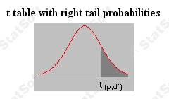
Computation of 95% Confidence Intervals
one-tailed p < .025
two-tailed p < .05
There’s a 95% probability that the interval contains the true mean
95%CI = SE * t_{df}
If n = 10, t₉ is 2.26
95%CI = 4.7 * 2.26 = 10.6
If n = 100, t₉₉ is ~1.96
95%CI = 1.5 * 1.96 = 2.94
∞ 1.96

Slide 24
What Do 95% Confidence Intervals Tell You?
120
SD = 15
If n = 10, SE = 4.7
If n = 10, 95%CI = +/-10.6
100
80
Happiness
60
40
20
0
Non-drug takers
Drug
takers
95%CIs tell you that the true IQ of drug takers is probably between 99.4 and 120.6. Because this interval includes 100, you cannot say with sufficient certainty that drug takers are smarter than the population norm of 100 expected for IQ.

Slide 25
SE → 95% CI
Rule of Thumb: Given the t distribution, 95%CI are typically 2X to 3X the SD, depending on sample size
∞ 1.96

Slide 26
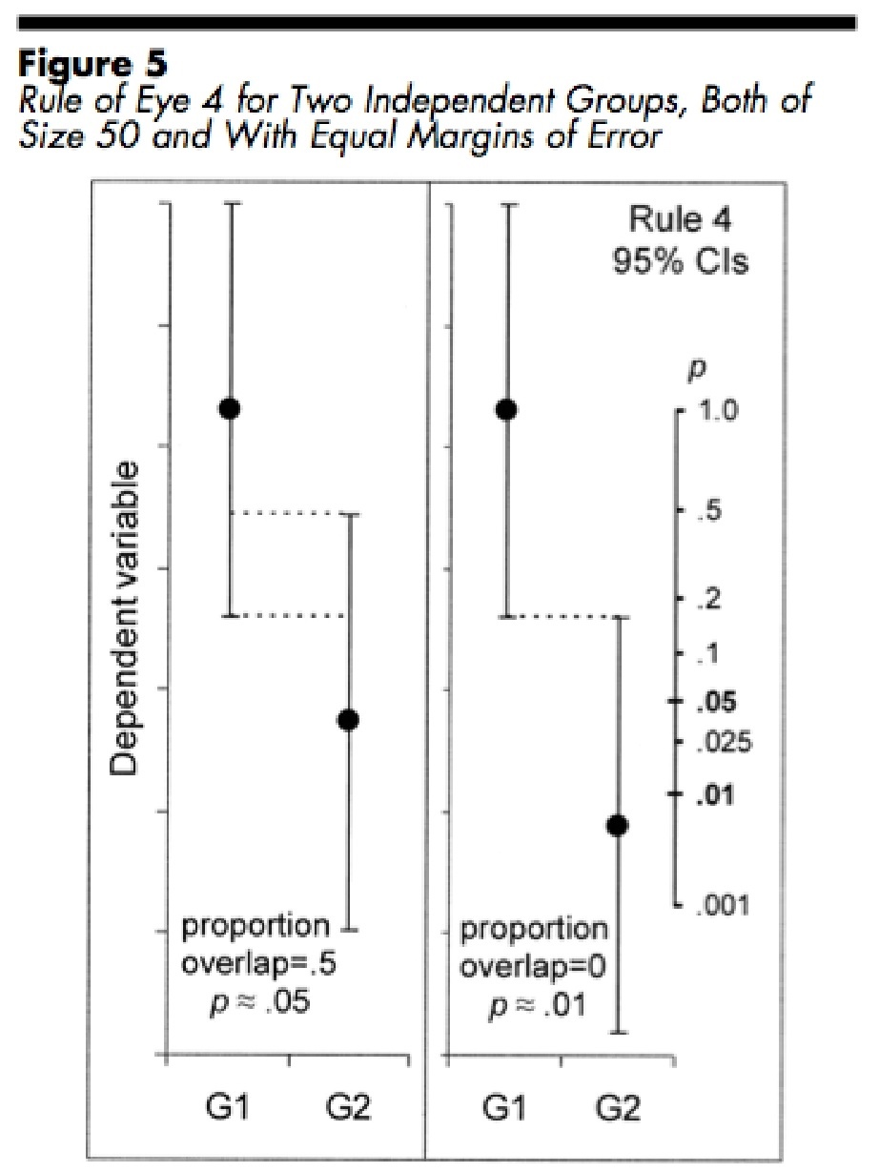
Group Differences: 95%CI Rule of Eye
Error bars can be informative about group differences, but you have to know what to look for
Rule of eye for 95% CIs:
If the overlap is about half of one one-sided error bar, the difference is significant at ~ p < .05
If the error bars just abut, the difference is significant at ~ p < .01
works if n >= 10 and error bars don’t differ by more than a factor of 2
Cumming & Finch, 2005

Slide 27
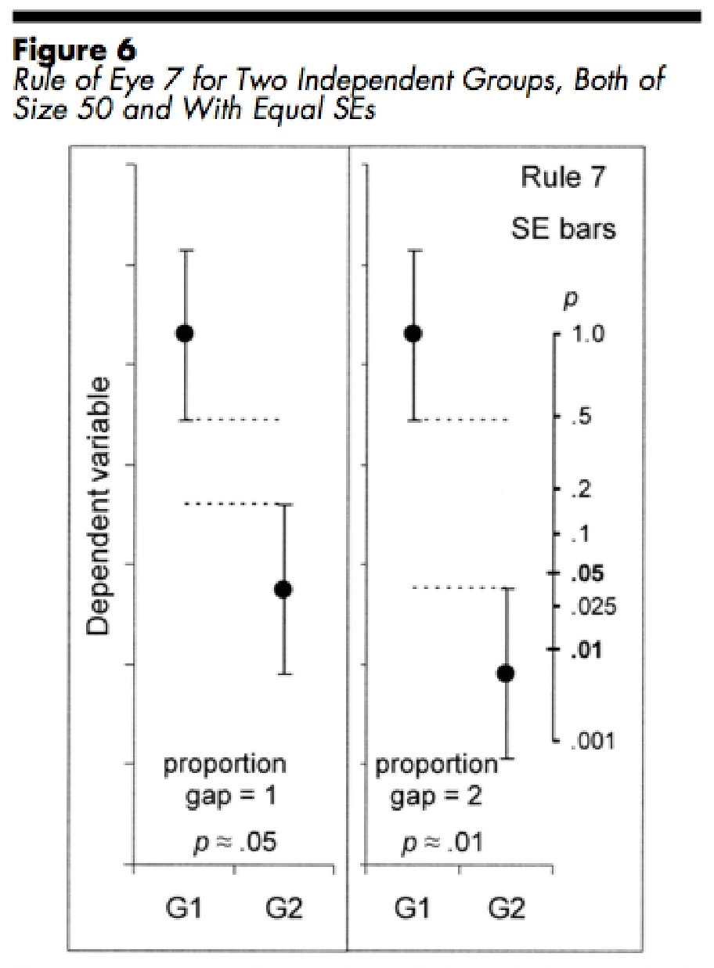
Group Differences: SE Rule of Eye
Rule of Eye for SEs
when gap is about the size of a one-sided error bar, the difference is significant at p < .05
when the gap is about the size of two one-sided error bars, the difference is significant at about p < .01
works if n >= 10 and error bars don’t differ by more than a factor of 2
Cumming & Finch, 2005

Slide 28
Hypothetical Experiment
Because people differ in IQ for many reasons, a better experimental design to test whether the drug improves IQ is to test IQ before and after people start taking the drug and look for changes from their baseline IQ (within-subjects design)

Slide 29
What About Within-Subjects Designs?
error bars can tell you about the likely means but not about whether differences between conditions are significant
Differences will be significant if the trend is similar between subjects, even if their initial values are variable
Differences will not be significant if the trend is highly variable across individuals
Error bars reflect variability between subjects, not consistency of trend
120
100
80
IQ
conventional error bars
will look the same for the yellow and green scenarios
60
40
20
0
Before
Drug
After
Drug

Slide 30
What About Within-Subjects Designs?
error bars can tell you about the likely means but not about whether differences between conditions are significant
Error Bars:
+/- 95%CI
120
20
doesn’t include zero → sig
includes zero → non-sig
100
80
IQ
conventional error bars
will look the same for the blue and pink scenarios
IQ Change After Drug
60
10
40
20
0
0
Before
Drug
After
Drug
A paired t-test basically does an evaluation of such differences

Slide 31
How Many Scientists Understand This?
When Belia et al., 2005, asked their scientist subjects to do the error bar adjustment on a within-subjects design, only 11% expressed any doubt that it was a valid thing to do

Slide 32
So What Should You Do?: Between-Ss Designs
Don’t use error bars?
reviewers may demand them
they can be informative
Use SE but put stat comparisons on graphs?
can make graphs look dense
Use 95%CI?
reviewers are used to SE and may think that 95%CI bars look too large
can emphasize 95%CI and interpretation
e.g., “Error bars are 95% confidence intervals (2.26 x SE for df=9).”
e.g., “The 95% confidence intervals for the beta weights do not include zero, indicating that the activation was significantly higher than baseline.”

Slide 33
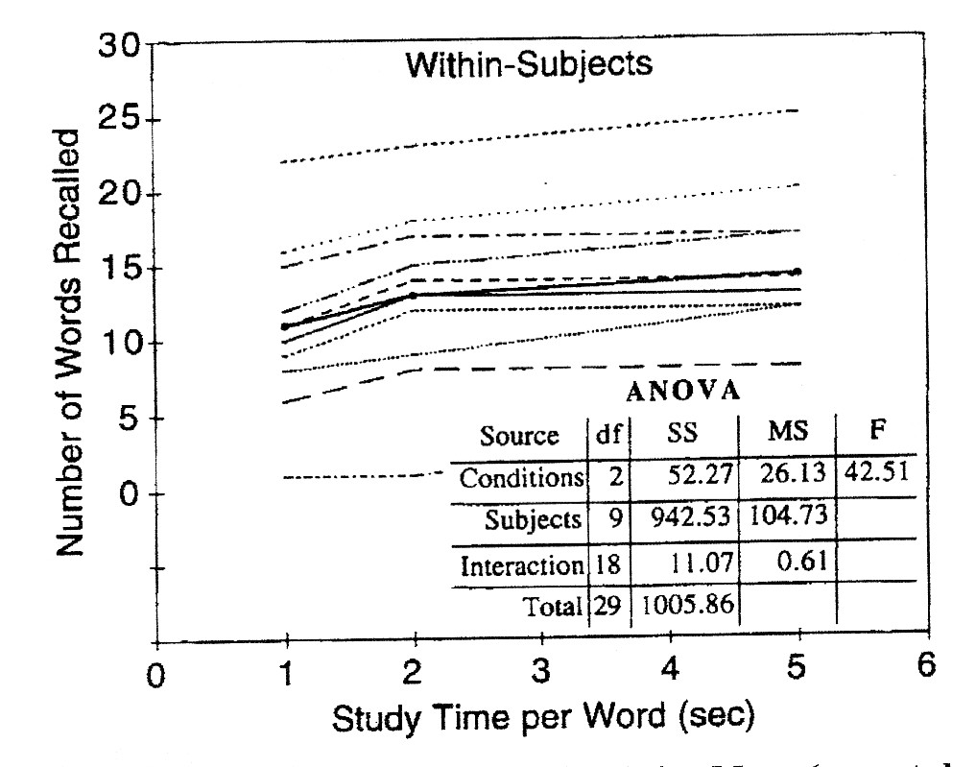
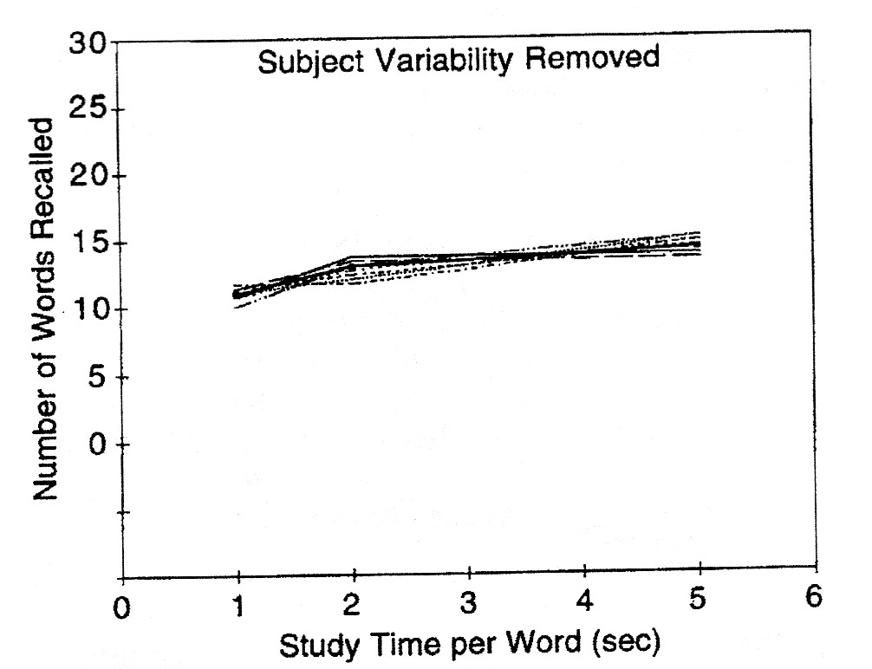
So What Should You Do?: Within-Ss Designs
You can show the pattern in single subjects. If it’s consistent, the pattern should jump out
If the emphasis is on differences between conditions, you can factor out subject differences
e.g., subtract subject means
variability due to condition manipulation only
all variability
Loftus & Masson, 1994

Slide 34
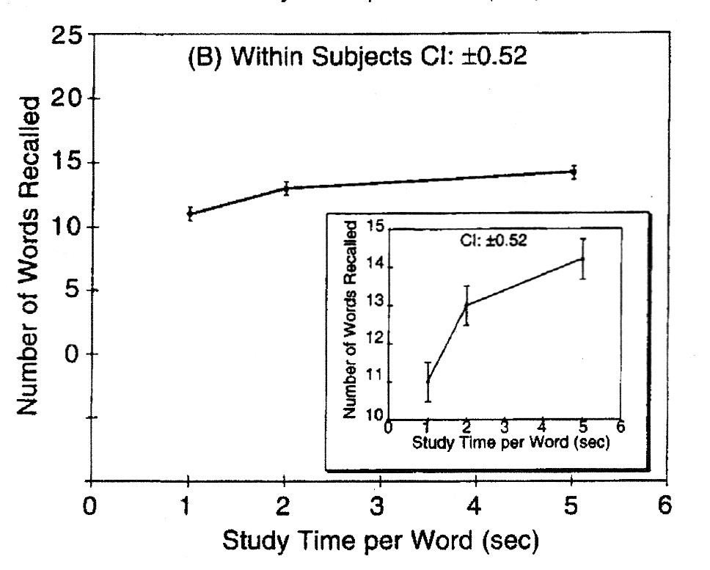
So What Should You Do?: Within Designs
You can compute more meaningful error bars based on error terms from the ANOVA
See Loftus & Masson, 1994, Psych. Bull. and Rev.
Loftus & Masson, 1994

Slide 35
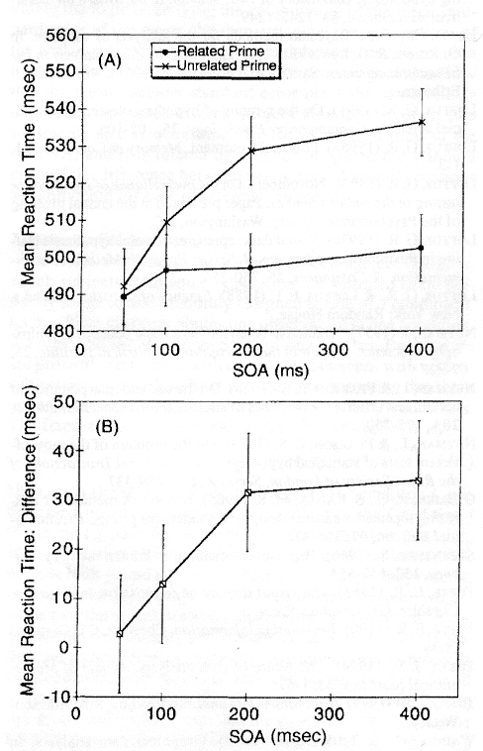
Options for Multifactorial Within Designs
show difference scores and their errors
can use slopes for parametric designs with ~linear trends
Loftus & Masson, 1994

Slide 36
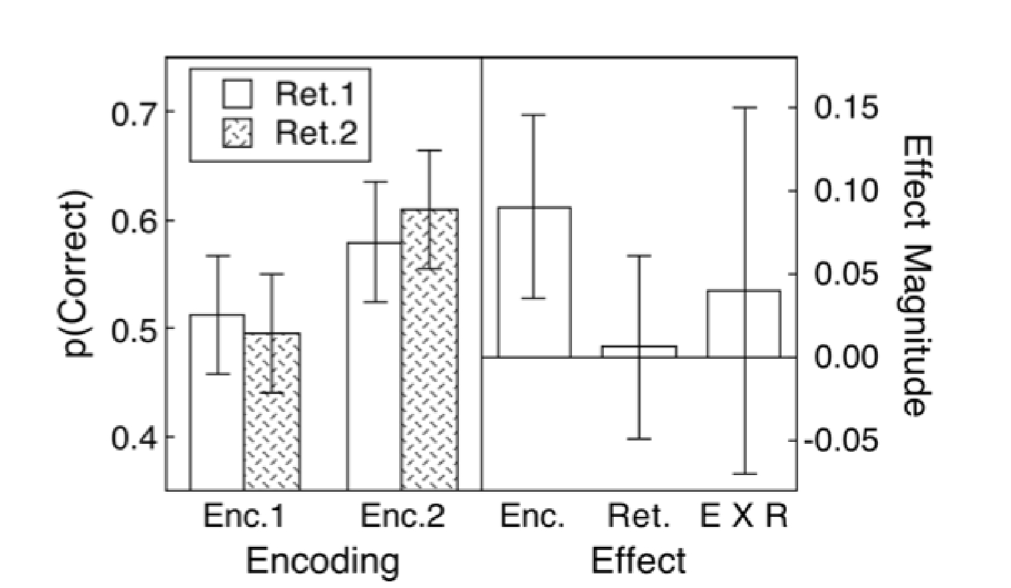
Options for Multifactorial Within Designs
You can plot effect sizes and their error bars
See Masson & Loftus, 2003, Can. J. Exp. Psychol.
Masson & Loftus, 2003

Slide 37
Bibliography
Belia, S., Fidler, F., Williams, J., & Cumming, G. (2005). Researchers misunderstand confidence intervals and standard error bars. Psychological Methods, 10(4), 389-396.
summarizes scientists’ (usually incorrect) intuitions
Cumming, G., & Finch, S. (2005). Inference by eye: Confidence intervals and how to read pictures of data. American Psychologist, 60(2), 170-180.
good summary of rules of thumb and caveats
Loftus, G. R., & Masson, M. E. (1994). Using confidence intervals in within-subject designs. Psychonomic Bulletin & Review, 1(4), 476-490.
original proposal for simple within-subjects error bars
Masson, M. E. J., & Loftus, G. R. (2003). Using confidence intervals for graphically based data interpretation. Canadian Journal of Experimental Psychology, 57(3), 203-220.
reiterates Loftus & Masson, 1994, and expands on error terms for complex within-subjects designs

Slide 38
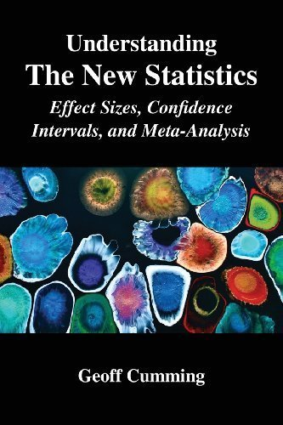
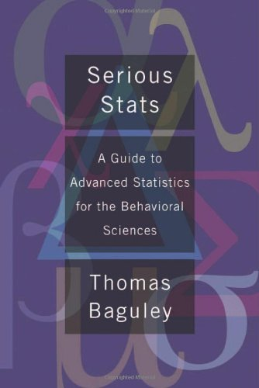
Bibliography
Cumming, G. (2014). The new statistics: Why and how. Psychological Science, 25(1), 7-29.
review article summarizing alternatives to NHST
Cumming, G. (2012). Understanding the New Statistics: Effect Sizes, Confidence Intervals, and Meta-Analysis. Routledge: New York.
book summarizing alternatives to NHST
Baguely, T. (2012). Serious Stats: A Guide to Advanced Statistics for the Behavioral Sciences. Palgrave Macmillan: New York.
book that reviews NHST and alternatives like Bayesian approaches
includes examples from SPSS and R

